Slide 1


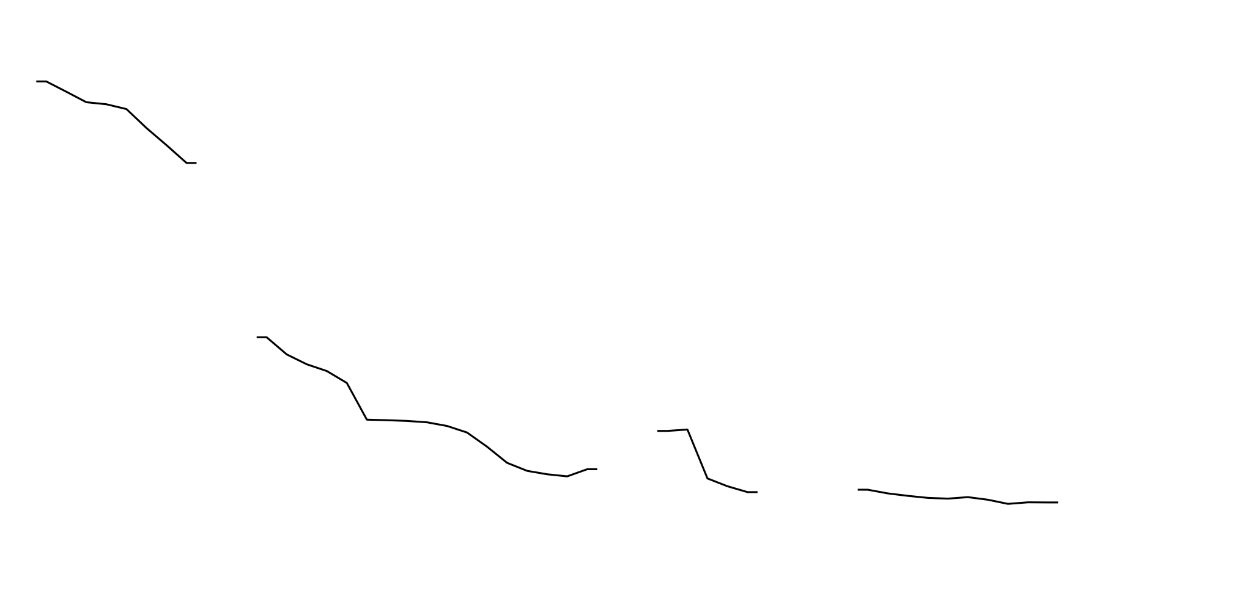
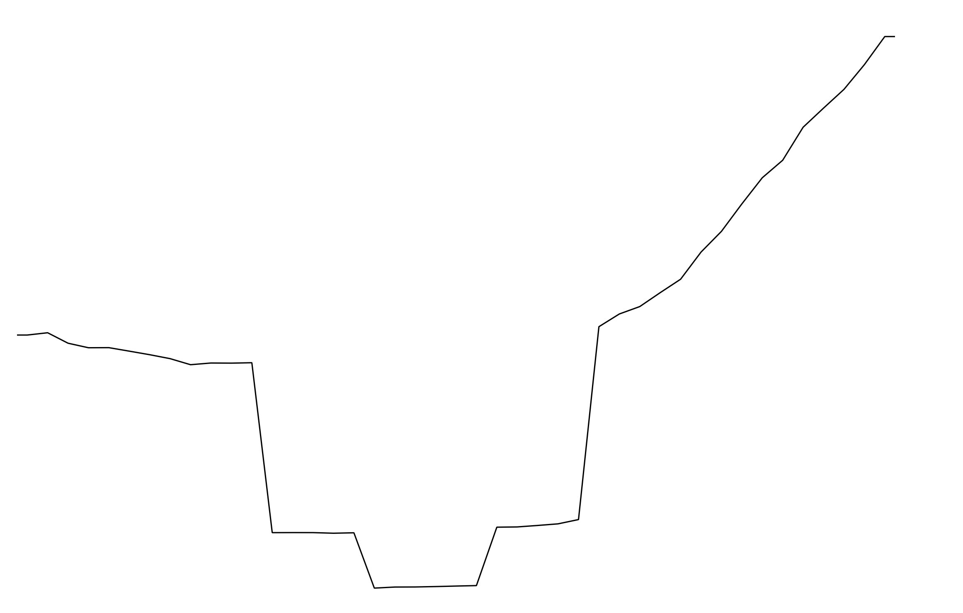
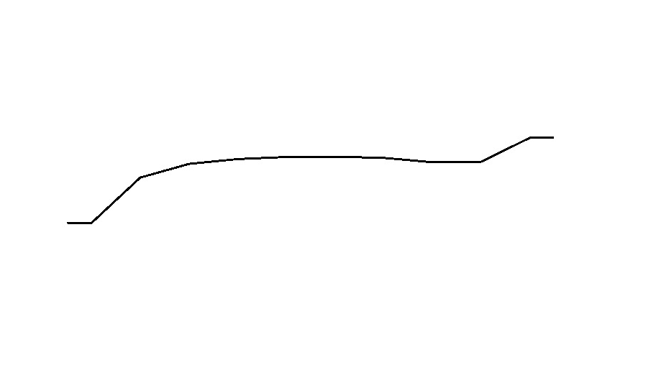
Acoustic and Gestural Highlighting in Maternal Speech Directed at Infants with Hearing Loss
Yael S. Stern, MA, Katie E. Zanzinger, MS CCC-SLP, Megan Y. Roberts, PhD, MS CCC-SLP
Early Intervention Research Group, Department of Communication Sciences and Disorders, Northwestern University, Evanston, IL
Background
Coding Schemes
Conclusions
Parents’ child-directed verbal input contains acoustic^{[1]} and gestural^{[2]} features that emphasize semantic, syntactic, phonological, and emotional aspects of verbal content, supporting language learning.^{[3,4]}
Mothers of infants with hearing loss (HL) do not reduce overall use of these highlighting strategies despite their child’s low responsivity to adult communication.^{[5,6]}
Relative to mothers of children with normal hearing (NH), mothers of children with HL may employ different types of highlighting strategies during interactions with their child, including increased use of deictic gestures and simple pitch manipulations.
Study Aims
To characterize nuanced differences between the use of acoustic and gestural highlighting by mothers of infants who have HL and NH.
GESTURE CODES ^{[10]}
Code | Definition | Example
Deictic - Contact | Indicate concrete objects/locations, involving physical contact with referent | Holding up a bottle to refer to a bottle
Deictic - Distal | Indicate concrete objects/locations, no physical contact with referent involved | Pointing to a cat across the room to refer to cat
Conventional | Movements that have social meanings | Wave bye-bye
Iconic | Miming of actions associated with an object/event to refer to that object/event | Moving finger in circle to indicate rolling of a wheel
PITCH CONTOUR CODES ^{[9]}
RISING FALLING
BELL REVERSE BELL
COMPLEX
FLAT
While this study revealed null findings, the results do support previous research that has found similarities between mothers of infant-toddlers with HL and NH in their use of highlighting strategies.
The current study extends previous work by demonstrating that not only are overall rates of these strategies comparable, but that relative proportions of gesture and contour types are comparable between age-matched groups.
It is promising that parents of children with HL do not reduce their use of these facilitative language strategies despite their children’s relatively delayed communicative abilities.
Methods
Results
Figure 2. Frequency of maternal gesture use and of gesture type proportions.
Limitations and Future Directions
Participants
19 normal hearing mothers and their 11-17 month old toddlers with congenital bilateral hearing loss prior to cochlear implantation (n = 10) or normal hearing (n = 9).
Procedures
Dyads were video-recorded playing in their home for 10 minutes with their own toys.
All utterances were transcribed according to conventions of Systematic Analysis of Language Transcripts, and coded using INTERACT Software.^{[7]}
Maternal utterances coded for the presence and type of gesture use, and pitch contour.
Qualitative hand-coding completed in Praat 4.6.17^{[8]} for all maternal utterances via individual visual inspection of contours, using a coding scheme adapted from Gratier and Devouche (2011).^{[9]}
Future studies will examine the relationship between these highlighting strategies and child language to determine optimal patterns of maternal highlighting.
Findings should be interpreted with caution given the small sample size, the heterogeneity of infants with hearing loss.
No significant difference between groups of mothers in overall frequency of gesture use, t(17) = 1.14, p = .27
No significant difference between groups of mothers in their relative frequency of using different gesture types:
Contact, t(17) = -1.07, p = .30
Distal, (17) = 1.80, p = .09
Conventional, t(17) = -.07, p = .94
Object, t(17) = 1.57, p = .14
 | Hearing Loss | Normal Hearing
Child age (months) | 14.45 (1.88) | 14.75 (1.91)
Language SS, PLS-5 | 91 (24.66) | 113.67 (8.54)
Cognitive SS, MSEL | 51.30 (15.95) | 48.00 (8.49)
Male (%) | 30 | 40
Caucasian (%) | 90 | 78
Maternal education (%)
4-yr degree or higher | 70 | 100
Hearing loss severity (%)
Mild-moderate or Moderate | 50
Severe or Profound | 50
References
[1] Fernald, A., & Simon, T. (1984). Expanded intonation contours in mothers’ speech to newborns. Developmental Psychology, 20(1), 104–113.
[2] Iverson, J. M., Capirci, O., Longobardi, E., & Cristina Caselli, M. (1999). Gesturing in mother-child interactions. Cognitive Development, 14(1), 57–75.
[3] Ramírez-Esparza, N., García-Sierra, A., & Kuhl, P. K. (2014). Look who’s talking: speech style and social context in language input to infants are linked to concurrent and future speech development. Developmental Science, 17(6), 880–891.
[4] Rowe, M. L., Özçalişkan, Ş., & Goldin-Meadow, S. (2008). Learning words by hand: Gesture’s role in predicting vocabulary development. First Language, 28(2), 182–199.
[5] Kondaurova, M. V., & Bergeson, T. R. (2011). The Effects of Age and Infant Hearing Status on Maternal Use of Prosodic Cues for Clause Boundaries in Speech. Journal of Speech, Language, and Hearing Research, 54(3), 740–754.
[6] Spencer, P. E. (1993). Communication behaviors of infants with hearing loss and their hearing mothers. Journal of Speech and Hearing Research, 36(2), 311–321.
[7] Mangold (2017): INTERACT User Guide. Mangold International GmbH (Ed.) www.mangold-international.com
[8] Paul Boersma & David Weenink (2016): Praat: doing phonetics by computer [Computer program]. Version 4.6.17, retrieved 21 April 2016 from http://www.praat.org/
[9] Gratier, M., & Devouche, E. (2011). Imitation and repetition of prosodic contour in vocal interaction at 3 months. Developmental Psychology, 47(1), 67–76. https://doi.org/10.1037/a0020722
[10] Crais, E. R., Watson, L. R., & Baranek, G. T. (2009). Use of gesture development in profiling children’s prelinguistic communication skills. American journal of speech-language pathology, 18(1), 95-108.
Figure 3. Distributions of maternal use of IDS contour shapes.
No significant difference between groups of mothers in distribution of IDS utterance contour use.
More Information
Yael S. Stern, yael.stern@u.northwestern.edu
This study was funded by the National Institutes of Health: NIDCD (R03DC012639).
Disclosure statement: Yael Stern: No conflict of interest; Katie Zanzinger: No conflict of interest; Megan Y. Roberts: No conflict of interest.
Notes:
Independent samples t-tests were used to conduct group comparisons for analysis of (1) frequency of gesture use, (2) distribution of gesture use type, and (3) distribution of IDS utterance contour use.
Examples of each pitch contour code, adapted from coding scheme by Gratier and Devouche (2011).
How do mothers of infants with HL and mothers of infants with NH differ in the type and frequency of (1) acoustic adjustments and (2) gesture use to support the verbal input they direct at their child?

