Slide 1
Partnering in Play:
Teaching Caregivers to Support Language Development Through Play
ASHA 2018, #1332
Marie Bloem, M.A., CCC-SLP
Molly Strauss, M.S., CCC-SLP
Katie Zanzinger, M.S., CCC-SLP
Megan Roberts, PhD, CCC-SLP
November 16, 2018
Boston, MA
Notes:
Katie

Slide 2
DISCLOSURES:
FINANCIAL:
Ms. Bloem, Ms. Roberts, Ms. Strauss, and Ms. Zanzinger are employees of and receive
salary from Northwestern University. They are members of the Early Intervention Research
Group, which receives research grants from the National Institutes of Health and from the Institute of Education Sciences.
NON-FINANCIAL:
No relevant nonfinancial relationship exists.
PERMISSIONS:
Parents have all given written permission to share their videos for training purposes.
You are not permitted to photograph or record the presentation.
Notes:
Katie

Slide 3
Notes:
Katie
We are a part of the EIRG, a federally funded group of scientists and clinicians at NU under Megan Roberts.
We love the tiny humans and spend our time researching and testing ways to maximize their communication outcomes through
Naturalistic language interventions, specifically EMT
Home-based parent coaching
Supporting EI providers
We’re currently running 4 clinical trials spanning ASD, HL and DLD.

Slide 4
1 FRAMEWORK
2 PLAY LEVELS
3 STRATEGIES
4 COACHING
5 CLOSING / Q & A
OUTLINE
Notes:
Katie
Here’s where we’re headed!
Today we’re talking about supporting toddlers’ language development within the context of play.
Just to get a feel of the room, how many of you currently work with one and two year olds?
And how many of you see the children in their homes?
The work of an EI therapist is really hard. We need to have a multi-layered understanding of our strategies.
First we need to know ourselves what to do with a kid.
But also, we need to know how to teach and train parents in these strategies (which is a whole other ball game!)
So today we hope to help integrate these two layers.
We’ll start by going over why we do what we do so we have a framework to work from.
Then we’ll go into how play develops in young children and how we can assess it
Next we’ll move into concrete intervention strategies (that’s the what to do part)
Then we’ll talk about how to integrate those strategies into an evidence-based coaching model
And we’ll wrap up with some time hopefully left over for some questions.
We’ll have some activities and videos throughout, but we have a full program, so we’ll need to save questions until the end so that we can get through everything.

Slide 5
>
WHY PLAY
1
FRAMEWORK
>
WHY CAREGIVERS
Notes:
Molly

Slide 6
FRAMEWORK
SKILLS
Play helps build a variety of skills
Language^{12, 23}
Motor²⁰
Cognitive^{15, 21}
Social-Emotional¹
>
WHY PLAY WHY CAREGIVERS
NATURAL CONTEXT
Play is a natural context in which children frequently engage with their caregivers.
Notes:
Molly
SKILLS:
Language:
Language and play milestones align closely
Ex. Toddlers combine words around the same time they combine play actions
Motor:
Children develop their motor skills as they manipulate objects and toys
Cognitive:
Recent meta-analysis (Quinn 2018) closely linked play and cognitive skills (cause/effect, object permanence)
Social-Emotional:
Natural context to practice sharing, directing, and following other’s attention
NATURAL CONTEXT:
We need to be embedding our intervention within routines that are already taking place in the home.
Play serves as one of these contexts (but not the only)
12. Lifter, K., Foster-Sanda, S., Arzamarski, C., Briesch, J., McClure, E. (2011). Overview of play: Its uses and importance in early intervention/early childhood special education. Infants & Young Children, 24(3) 225-245.
23. Ungerer, J. & Sigman, M. (1981). Symbolic play comprehension in autistic children. Journal of Child & Adolescent Psychiatry, 20 (2) 318-337.
20. Stagnitti, K., & Unsworth, C. (2000). The importance of pretend play in child development: An occupational therapy perspective. British Journal of Occupational Therapy, 63(3), 121-127.
15. Quinn, S., Donnelly, S., & Kidd, E. (2018). The relationship between symbolic play and language acquisition: A meta-analytic review. Developmental Review, (49), 121-135.
21. Tamis Le-Monda, C.S., Shannon, J.D., Cabrera, N.J., Lamb, M.E. (2004). Fathers and mothers at play with their 2- and 3-year-olds: Contributions to language and cognitive development. Child Development, 75(6), 1806-1820.
1. Bigelow, A. E., MacLean, K., & Proctor, J. (2004). The role of joint attention in the development of infants’ play with objects. Developmental Science, 7(5), 518-526

Slide 7
FRAMEWORK
EXPERTISE
Parents provide critical expertise to the team.
EMPOWERMENT
WHY PLAY WHY CAREGIVERS
Involvement increases capacity for self-reflection and self-evaluation¹⁸
>
EFFECTIVENESS
Research demonstrates that training caregivers is the most effective service-delivery model.
Dosage
Caregiver language impact ^{8, 21, 24}
Efficacy trials and comparison analyses ^{16, 17, 18}
Notes:
Molly
EXPERTISE:
We know the language strategies, but they know their child best. We need their knowledge
EMPOWERMENT
Having a child with disabilities often means having a stream of professionals coming through your home and offering their opinions about your child, which can be a dis-empowering experience.
But we can help to change that. Siller and colleagues found that using a coaching model can help support parent empowerment.
Siller, M., Hotez, E., Swanson, M., Delavenne, A., Hutman, T., & Sigman, M. (2018). Parent coaching increases the parents’ capacity for reflection and self-evaluation: results from a clinical trial in autism. Attachment & human development, 20(3), 287-308.
EFFECTIVENESS:
Dosage:
We need the dosage that parents can provide. We know that 1 hour a week is not enough.
Increase dosage without increased cost – more bang for our buck!
If a parent uses the strategies during one 30 min routine a day (e.g. mealtime), the child receives 3-4x more therapy!
Caregiver Language Impact:
Caregivers are their child’s primary language model
Studies have linked the following domains with language outcomes
Amount of child-directed speech
Diversity of parent language
Parent responsiveness to child communication
Efficacy Trials and Comparison Analyses
RCT on parent-mediated intervention
Meta-analysis comparing parent to therapist-only interventions
>>>>See next slides

Slide 8
FRAMEWORK
¹⁷ RCT Efficacy Trial:
Do Parent-Implemented Interventions Work?
Intervention
(45 children)
2 sessions/week
3 months
Receptive Lang: Improvements in all areas
Expressive Lang: Increased NDW
Caregivers reported using the strategies on average 17 hours per week.
Caregivers did not report additional stress
97 children
Control
(52 children)
Care as usual
Roberts, M. Y., & Kaiser, A. P. (2015). Early intervention for toddlers with language delays: a randomized controlled trial. Pediatrics, 135(4), 686-693.
8
Notes:
Molly
Receptive language with small effect sizes (0.27 to 0.35, p=0.04),
Expressive language in number of different words used during a structured play assessment

Slide 9
FRAMEWORK
¹⁸ Meta-Analysis:
Do Parent-Implemented Interventions Work Better?
Population:
18-60 months
Primary or secondary language impairments
Studies Included:
18 studies met pre-determined criteria
Interventions lasted 10-13 weeks
Interventions had <26 hours of parent training
Results:
Interventions had significant, positive impact on receptive and expressive language abilities
Roberts, M.Y. & Kaiser, A.P. (2011). The effectiveness of parent-implemented language interventions: A meta-analysis. American Journal of Speech-Language Pathology, 20(3), 180-199.
9
Notes:
Molly

Slide 10
FRAMEWORK
¹⁸ Meta-Analysis:
Do Parent-Implemented Interventions Work Better?
significant
Roberts, M.Y. & Kaiser, A.P. (2011). The effectiveness of parent-implemented language interventions: A meta-analysis. American Journal of Speech-Language Pathology, 20(3), 180-199.
Notes:
Molly

Slide 11
>
HIERARCHY
2
PLAY LEVELS
>
ASSESSMENT
>
GOALS
Notes:
Katie
Now that we have a framework for why we teach caregivers to use play, we’ll dive deeper into play levels.
Understanding and identifying play a child’s play level is important for several reasons.
Perhaps most importantly is it supports engagement. (especially true for children with ASD).
Too high, we’ll lose them
Too low, they’ll get bored.
Gives us a framework for monitoring and supporting a child’s development. We know what their “next steps” are.
We’ll talk about how we
conceptualize the hierarchy of different play development,
A simple way that we can systematically assess play,
And how we can write formal or informal goals to target play

Slide 12
PLAY LEVELS
1
SIMPLE
COMBINATION
PRE-SYMBOLIC
SYMBOLIC
>
HIERARCHY ASSESSMENT GOALS
2
3
4
Notes:
Katie
Ungerer, J. & Sigman, M. (1981). Symbolic play comprehension in autistic children. Journal of Child & Adolescent Psychiatry, 20 (2) 318-337.
Note the chart that is included in your handouts.

Slide 13
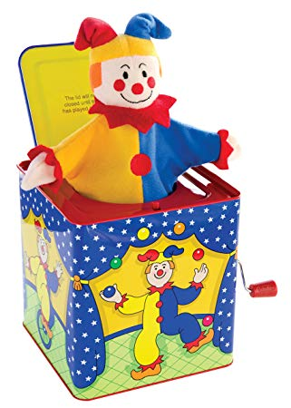
PLAY LEVELS: HIERARCHY
1
6 - 12 months
SIMPLE
COMBINATION
PRE-SYMBOLIC
SYMBOLIC
Sensory exploration, cause and effect manipulating a single object at a time
Notes:
Katie

Slide 14
PLAY LEVELS: HIERARCHY
VIDEO
14
Notes:
Katie
No sound

Slide 15
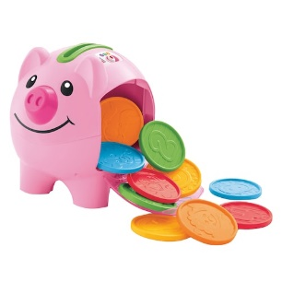
PLAY LEVELS: HIERARCHY
12 months
SIMPLE
COMBINATION
PRE-SYMBOLIC
SYMBOLIC
Simple manipulation and using multiple objects at a time
2
General combination
Fitted combination
Associated combinations
Toy specific combinations
Notes:
Katie
General – in on out (ball in box)
Fitted - puzzles
Associated – spoon in bowl
Toy specific – build structure out of blocks

Slide 16
PLAY LEVELS: HIERARCHY
VIDEO
16
Notes:
Katie
No sound

Slide 17
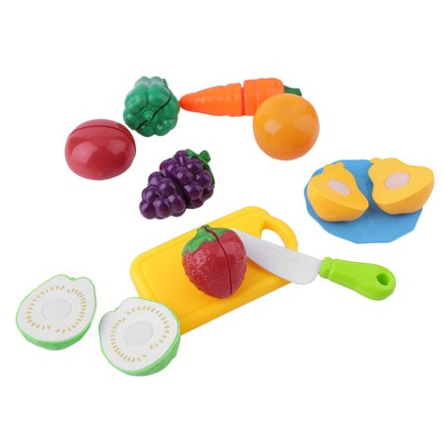
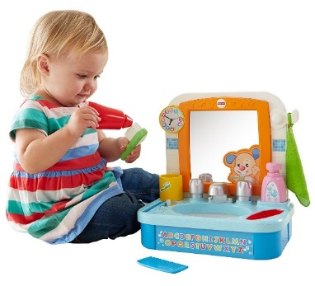
PLAY LEVELS: HIERARCHY
12 – 18 months
SIMPLE
COMBINATION
PRE-SYMBOLIC
SYMBOLIC
Pretending to use objects for their intended purpose
Self-directed
Directed towards others
3
Notes:
Katie
*also called “functional”
Familiar daily routines

Slide 18
PLAY LEVELS: HIERARCHY
VIDEO
18
Notes:
Katie

Slide 19
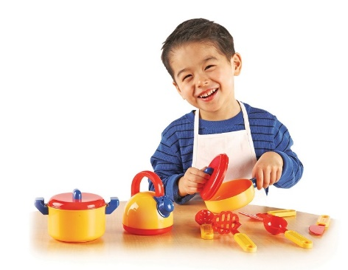
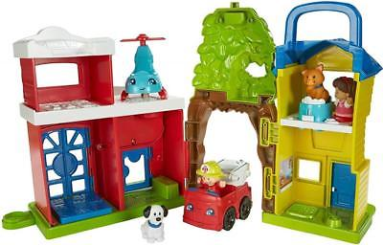
PLAY LEVELS: HIERARCHY
15 – 24 months
Separate knowledge of an object from its representation, and sequence multiple actions into coherent play scheme
SIMPLE
COMBINATION
PRE-SYMBOLIC
SYMBOLIC
Substitution
Imaginary
4
Notes:
Katie

Slide 20
PLAY LEVELS: HIERARCHY
VIDEO
20
Notes:
Katie

Slide 21
PLAY LEVELS
1
PURPOSE
MATERIALS
ADMINISTRATION
SCORING
HIERARCHY ASSESSMENT GOALS
2
>
3
4
Notes:
Marie

Slide 22
PLAY LEVELS: ASSESSMENT
1
Provides critical information about a child’s play
PURPOSE
MATERIALS
ADMINISTRATION
SCORING
Unsupported play level
Diversity of play
Frequency of play acts
Strengths and weaknesses
Play preferences
Notes:
Marie

Slide 23
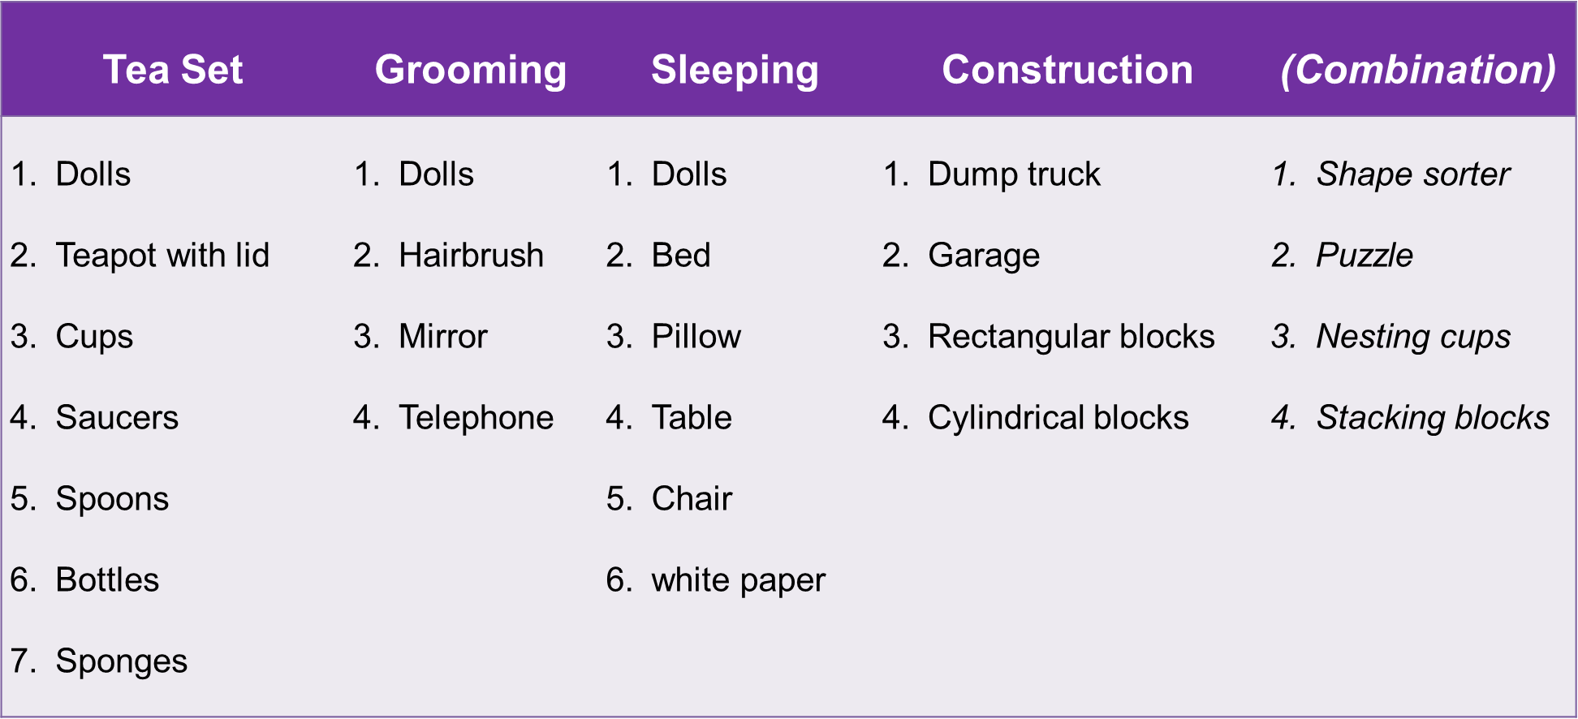
PLAY LEVELS: ASSESSMENT
PURPOSE
MATERIALS
ADMINISTRATION
SCORING
2
Notes:
Marie

Slide 24
PLAY LEVELS: ASSESSMENT
Observe
Prompt
Model
PURPOSE
MATERIALS
ADMINISTRATION
SCORING
3
Notes:
Marie
Present toy sets one-by-one
Observe: praise for engagement, but do not model or give directions
Prompt: “the bear is hungry” “oh no, baby is dirty” “where does this piece go?” – no gestural cues
Model: different level play acts (gradually moving up)
Move on to the next set if the child is uninterested.

Slide 25
PLAY LEVELS: ASSESSMENT
Play Level | Examples | Observed | Prompted | Modeled
Early Play | Squeezes dolls, stands up the bottle | ✓ | n/a | n/a
Combination / Relational Play | Takes lid on or off the teapot, puts sponge in the cup | ✓ | n/a | n/a
Pre-symbolic / Functional Play | Pretends to eat off of the spoon, feeds baby with the spoon | X | X | ✓
Symbolic / Pretend Play | Uses sponge as food, feeds dolls, wipes it’s face, and then puts it to bed | X | X | X
PURPOSE
MATERIALS
ADMINISTRATION
SCORING
4
Notes:
Marie
(goal examples, for later: demonstrate spontaneous pre-symbolic play)

Slide 26
PLAY LEVELS
HIERARCHY ASSESSMENT GOALS
1
LEVELS
PLANNING
2
>
Notes:
Marie
Goals may be formal or informal depending on where you work. This may be as simple as “knowing what is next” and what the “next higher skill” is.

Slide 27
PLAY LEVELS: GOALS
CURRENT LEVEL
The most frequent spontaneous act across sets reveals the level the child is most comfortable playing.
LEVELS
PLANNING
1
NEXT LEVEL
Higher levels that are demonstrated infrequently, occur with only one toy set, or appear only when given support suggest emerging skills
Notes:
Marie
Conceptualize the level the child is at.

Slide 28
PLAY LEVELS: GOALS
GOAL:
To have the child complete the target level of play without support
LEVELS
PLANNING
2
INTERVENTION PLAN:
Join the child at their preferred play level and scaffold higher-level skills
Notes:
Marie
Examples:

Slide 29
1
FOLLOW CHILD’S LEAD
ARRANGE ENVIRONMENT
MIRROR AND MAP
BUILD PREDICTABLE STEPS
EXPAND PLAY
2
3
INTERVENTION STRATEGIES
3
4
5
Notes:
Marie

Slide 30
INTERVENTION STRATEGIES
HOW:
Follow child’s ideas and preferences
Be flexible in how you play with toys
Notice child’s behavior
Avoid questions
Avoid directions
1
FOLLOW
THE CHILD’S
LEAD
WHY:
This creates responsive interactions that align with how children learn at this early age
Following the child’s lead naturally reinforces and encourages the child’s play and communication
Notes:
Marie
This is a bit of a buzzword within EI, but let’s think about what it looks like specifically.
Follow child’s ideas and preferences
This often means having multiple toy options available. If a child thinks of a new idea, run with it. In the beginning, we’ll do more imitating and joining in than modeling.
Be flexible in how you play with toys
It’s the norm to go into a session with a set of toys and your plan and goals. But we need to be flexible in our ideas to follow how the child is interested in playing. E.g. child may want to put the pieces into a potato head all mixed up, but we can roll with that!
Notice child’s behavior
We should adjust our behavior based on a child. Are they bored? Frustrated? Having a blast? Trying to run away all the time? We need to notice this and respond appropriately to maintain engagement.
Avoid questions
Avoid directions
These are the hardest parts of following the child’s lead! But when we ask questions and directions, we’re the ones in the lead.
>If we eliminate questions, the child has the opportunity to lead and initiate communication.
>If we avoid directions, then the child has the opportunity to initiate and come up with play ideas. This creates an interaction where we are responding instead of directing. And that’s how kids learn best.
***this often creates a vacuum! We’ll go over some other strategies of what to do instead.
Caveat here: this is a foundational strategy, but this doesn’t mean that we’ll never push or stretch a child – we’ll just do it within the context of their interests and initiations.
Another caveat: sometimes with our children with ASD, they may not be giving us much or any lead to follow when it comes to toys. We’ve often seen where a child doesn’t use any objects functionally, and that’s when we would pull in some of our other strategies we’ll talk about in a moment.
VIDEO NOTES: 39- switches toys, nesting not stacking, drops shapes in top

Slide 31
INTERVENTION STRATEGIES
VIDEO
Notes:
Marie
39- switches toys, nesting not stacking, drops shapes in top

Slide 32
INTERVENTION STRATEGIES
HOW:
Get face to face
Remove distractions
Remove inappropriate toys
Assist child with difficult motor play actions
Lay out a few appropriate toy options around the room partially set up
2
ARRANGE
THE
ENVIRONMENT
WHY:
Arranging the environment sets the stage for a great play interaction
It allows the child to lead the play while giving us opportunities to scaffold higher levels
Notes:
Marie
49- move toy to her, handing materials, moving fast, reducing support (HOH, give, set out)
Get face to face
May seem simple, but sitting across from each other (rather than in your lab or next to)encourages a social interaction
Remove distractions
Keeping the play area organized as you go will help keep the play organized. A clear and organized play area can visually support functional play
Remove inappropriate toys
This may be an electronic toy
Assist child with difficult motor play actions
We’re SLPs, not OTs. So we’ll assist with difficult motor actions so that we don’t lose engagement, because that is our goal in the moment. E.g. line up the shapes for the shape sorter so that they only have to push it in.
Lay out a few appropriate toy options around the room partially set up
This can be a really effective visual cues. If we’re trying to keep the child engaged in play, having the nesting blocks partially stacked, with the rest of them sitting out makes it visually very clear how to join back into the play. Imagine the difference between that and having all of the blocks spread out across the room.

Slide 33
INTERVENTION STRATEGIES
VIDEO
Notes:
Marie

Slide 34
INTERVENTION STRATEGIES
HOW:
Imitate the child’s play act (mirror), and then label the action (action)
3
MIRROR
AND MAP
WHY:
This provides a practical way to join in play with the toys
Models commenting in play
Promotes receptive language of verbs
Notes:
Marie
This is a strategy that we can use instead of giving directions or asking questions.
The strategy is as simple as…
E.g. stacking blocks
This provides a practical way to join in play with the toys
i.e. start with imitating!
Models commenting in play
Now we’re modeling commenting instead of questions! These are phrases that the child can then imitate and use functionally.
Promotes receptive language of verbs
We know that verbs are so important for early language learners, but so often our intervention can look so noun heavy. M/M allows us to model those action words really clearly in context.
Notes:
You can do M/M in a couple of ways. 1. you can imitate after the child does an action and say the word. 2. you can do the action with the child as you do the action together.
The important thing is that you are joining in the action with the child.
M/M is in place of narrating (our play or the child’s play). The meaning of the words will be most meaningful when you’re doing the action together.

Slide 35
INTERVENTION STRATEGIES
VIDEO 1
VIDEO 2
VIDEO 3
Notes:
Marie

Slide 36
INTERVENTION STRATEGIES
HOW:
Start with the child’s preferred actions
Find a way to restart and do the same actions again
4
BUILD
PREDICTABLE
STEPS
WHY:
Promotes independence in play
More likely to engage on their own when they know what to expect
Adult uses consistent language models
Notes:
Marie
How:
Start with the child’s preferred action(s)
What is the child doing with the toy right now?
>E.g. Stacking blocks?
>Cutting pretend fruit?
We take what they are doing and create a little routine out of it that we can repeat.
>E.g. Stack the blocks and crash (and then start over!).
>Cut apart all of the pretend fruit, then put them all together and cut again.
Find a way to restart and do the same action(s) again
Each of those routines as a “restarting” component to them. We often need to be the ones initiating restarting (especially within ASD).
>So once the blocks are crashed, we stack one and hand the child the next block.
>Once we’ve cut apart all the fruit, we could hand the child two pieces of fruit to put back together, and then you’ve started the routine again.
This gives us a foundation (or what we call a base routine) that we can then build off of and add more steps and ideas to.
Parent Quote:
“I can see how when he’s left to his own devices, he tends to get frustrated more and he tends to not really stay focused so much and I think it’s helpful to have an order and a routine. And also when you have an order and a routine, it’s easier to introduce something new because everything else is familiar, and there’s something new and it’s more isolated and he can see it better. I can see how in the mind of a 2yo, when things are chaotic, it’s harder to learn. When things are very simple and there’s a step, and another step, then it’s easier.”

Slide 37
INTERVENTION STRATEGIES
VIDEO
Notes:
Marie

Slide 38
INTERVENTION STRATEGIES
HOW:
Slowly increase the complexity and/or diversity of the play
Set Out
Model
Hand
5
EXPAND
PLAY
WHY:
Adding additional actions and toys allows for modeling more diverse vocabulary
Helps to maintain engagement and keep the child from getting bored
Notes:
Marie
Building predictable steps provides us with a foundation that we can then expand off of.
The key here is to expand slowly. We add on one action or toy at a time.
Eg. Base routine is stacking the boxes. A play expansion would be to put little animals in all of the boxes. Then you would crash it, stack them again, put the people in, and then maybe model another expansion (adding a ladder or slide).
We can expand with different levels of support
>Simply set out a new toy
>Demonstrate/model a new action
>Give the child a new toy to do something with.
(I frequently do model and hand together).
Notes:
How many/how often you do expansions will depend on the child. For our children with ASD, rigidity can play a big role in how much they let us expand. In those cases you need to see what the child will tolerate and move slowly from there.
We sometimes think of play expansions as horizontal or vertical. Horizontal expansions stay within the same play level (we were cutting the fruit, now we’re going to put it in the bowl). Vertical expansions introduce a higher play level (we were cutting the fruit, now we’re going to feed it to a puppet).
We can’t make a child buy-in and follow along with our expansion. Our job is to model and facilitate and “woo” them into higher level play.
If at any point we feel like we’re losing their engagement because it’s getting too complicated or abstract, we can go back to our base routine.
1,2
1,2,3
1,2,3,4
1,2

Slide 39
INTERVENTION STRATEGIES
VIDEO 1
VIDEO 2
Notes:
Marie
Expansion of previous routine clip- birthday candles
Full routine and then expansion- stack balls, in salad spinner

Slide 40
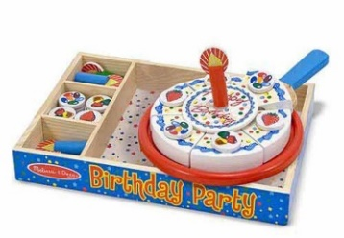
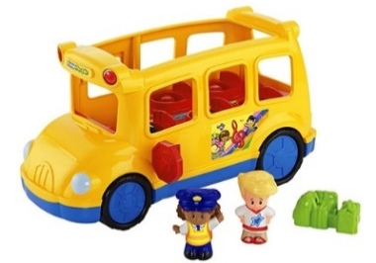
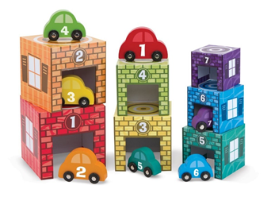
Group Activity — Brainstorm play routines and expansions for various toy sets
TOY SET | What do they do with the toy now? | What actions can we add? | What other toys could you add?
40
Notes:
Marie

Slide 41
1
TEACH
MODEL
COACH
REVIEW
4
COACHING
2
3
4
Notes:
Katie

Slide 42
COACHING
WHAT IT LOOKS LIKE:
1
Therapist is primarily interacting with the parent including reviewing the strategy and providing relevant examples for activities planned for this session
TEACH
MODEL
COACH
REVIEW
HOW:
Explain the strategy and why we use it
Walk through a child-specific example
Role-play scenarios for practice
Notes:
Katie

Slide 43
INTERVENTION STRATEGIES
VIDEO
Notes:
Katie
55- parent slightly distracted but listening

Slide 44
COACHING
WHAT IT LOOKS LIKE:
Therapist is primarily interacting with the child including demonstrating and highlighting the strategy of the day
TEACH
MODEL
COACH
REVIEW
2
HOW:
Demonstrate the strategy that was explained during the teach phase
Point out and highlight your use of the strategy in real time
Don’t let your narration interrupt the play or engagement
Notes:
Katie

Slide 45
INTERVENTION STRATEGIES
VIDEO
Notes:
Katie
34- mom not in frame but on couch, timing of my models

Slide 46
COACHING
WHAT IT LOOKS LIKE:
TEACH
MODEL
COACH
REVIEW
Parent is primarily interacting with the child while the therapist coaches them on how to set up and use the target strategy of the day.
3
HOW:
Shape parent behavior through specific praise and corrective feedback
Assist the parent in their play interaction (handing toys, giving ideas, managing behavior)
Notes:
Katie

Slide 47
INTERVENTION STRATEGIES
VIDEO
Notes:
Katie
51- far along so coaching on a lot and using more technical words

Slide 48
COACHING
WHAT IT LOOKS LIKE:
TEACH
MODEL
COACH
REVIEW
Therapist is primarily interacting with the parent including reviewing the parent’s use of strategies and the impact on the child
HOW:
4
Summarize how the parent used the strategy
Relate an example of parent’s behavior to child’s behavior
Engage in reflective discussion by using probing questions
Notes:
Katie

Slide 49
INTERVENTION STRATEGIES
VIDEO 1
VIDEO 2
Notes:
Katie
Reflective parent- not in frame right away but adjust later

Slide 50
1
PARENT REFLECTIONS
PROGRESS VIDEOS
COMMON CONCERNS
SUMMARY
Q & A
2
5
CLOSING
3
4
5
Notes:
Katie

Slide 51
CLOSING
1
PARENT REFLECTIONS
PROGRESS VIDEOS
COMMON CONCERNS
SUMMARY
Q & A
Notes:
Marie
“One big thing was before, and I feel bad saying this, I didn’t play with him. I would just watch him play. Because I didn’t know what to do. It’s easy to play with [sibling] because I can say “let’s do this” and they’ll pick up on it right away. And I was really at a loss with him. It made feel really sad because I just didn’t feel like we… I don’t want to say bond but… we weren’t playing together. And that kind of felt like a loss to me. But now I know I can play with him and it’s a lot better.”

Slide 52
CLOSING
VIDEO
Notes:
Marie
Quote then video:
“One big thing was before, and I feel bad saying this, I didn’t play with him. I would just watch him play. Because I didn’t know what to do. It’s easy to play with [sibling] because I can say “let’s do this” and they’ll pick up on it right away. And I was really at a loss with him. It made feel really sad because I just didn’t feel like we… I don’t want to say bond but… we weren’t playing together. And that kind of felt like a loss to me. But now I know I can play with him and it’s a lot better.”

Slide 53
CLOSING
PARENT REFLECTIONS
PROGRESS VIDEOS
COMMON CONCERNS
SUMMARY
Q & A
2
Notes:
Marie

Slide 54
CLOSING
VIDEO 1
VIDEO 2
Notes:
Marie
Same toy in both clips

Slide 55
CLOSING
VIDEO 1
VIDEO 2
Notes:
Marie

Slide 56
CLOSING
PARENT REFLECTIONS
PROGRESS VIDEOS
COMMON CONCERNS
SUMMARY
Q & A
3
Notes:
Marie

Slide 57
CLOSING
Well, this is a nice idea in theory, but…
…it isn’t the same as what I’ve always done and that was working just fine.
...parents don’t understand this model.
...parents don’t want to participate in my sessions.
COMMON CONCERNS
Notes:
Molly

Slide 58
CLOSING
PARENT REFLECTIONS
PROGRESS VIDEOS
COMMON CONCERNS
SUMMARY
Q & A
4
Notes:
Marie

Slide 59
CLOSING
Parents
Play
Child Outcomes
Notes:
Marie

Slide 60
CLOSING
PARENT REFLECTIONS
PROGRESS VIDEOS
COMMON CONCERNS
SUMMARY
Q & A
5

Slide 61
THANK YOU!

Slide 62
*
CITED & REFERENCED

Slide 63
Cited and Related References
Bigelow, A. E., MacLean, K., & Proctor, J. (2004). The role of joint attention in the development of infants’ play with objects. Developmental Science, 7(5), 518-526.
Dunst, C., & Trivette, C. (2009). Let’s be PALS: An evidence-based approach to professional development. Infants & Young Children, 22, 164-176.
Fewell, R. R., & Glick, M. P. (1993). Observing play: An appropriate process for learning and assessment. Infants & Young Children, 5(4), 35-43.
Frey, J. R., & Kaiser, A. P. (2011). The use of play expansions to increase the diversity and complexity of object play in young children with disabilities. Topics in Early Childhood Special Education, 31(2), 99-111.
Ginsburg, K. R. (2007). The importance of play in promoting healthy child development and maintaining strong parent-child bonds. Pediatrics, 119(1), 182-191.
Hampton, L. H., & Kaiser, A. P. (2016). Intervention effects on spoken‐language outcomes for children with autism: a systematic review and meta‐analysis. Journal of Intellectual Disability Research, 60(5), 444-463.
Hancock, T. B., Ledbetter-Cho, K., Howell, A., & Lang, R. (2016). Enhanced milieu teaching. In Early Intervention for Young Children with Autism Spectrum Disorder (pp. 177-218). Springer International Publishing.
Huttenlocher, J., Waterfall, H., Vasilyeva, M., Vevea, J., & Hedges, L. V. (2010). Sources of variability in children’s language growth. Cognitive psychology, 61(4), 343-365.
Kaiser, A. P., & Roberts, M. Y. (2013). Parents as communication partners: An evidence-based strategy for improving parent support for language and communication in everyday settings. Perspectives on Language Learning and Education, 20(3), 96-111.
Kelly-Vance, L., & Ryalls, B. O. (2005). A systematic, reliable approach to play assessment in preschoolers. School Psychology International, 26(4), 398-412.
Lifter, K. (1996). Assessing play skills. In M. McLean, D. B. Bailey, & M. Wolery (Eds.), Assessing infants and preschoolers with special needs (pp. 435–461). Englewood Cliffs, NJ: Prentice Hall.
Lifter, K., Foster-Sanda, S., Arzamarski, C., Briesch, J., McClure, E. (2011). Overview of play: Its uses and importance in early intervention/early childhood special education. Infants & Young Children, 24(3) 225-245.

Slide 64
Cited and Related References (con’t)
Linder, T. W. (1993). Transdisciplinary play-based assessment: A functional approach to working with young children, Rev. Paul H Brookes Publishing.
McConachie, H., & Diggle, T. (2007). Parent implemented early intervention for young children with autism spectrum disorder: A systematic review. Journal of evaluation in clinical practice, 13(1), 120-129.
Quinn, S., Donnelly, S., & Kidd, E. (2018). The relationship between symbolic play and language acquisition: A meta-analytic review. Developmental Review, (49), 121-135.
Roberts, M. Y., & Kaiser, A. P. (2015). Early intervention for toddlers with language delays: a randomized controlled trial. Pediatrics, 135(4), 686-693.
Roberts, M. Y., Kaiser, A. P., Wolfe, C. E., Bryant, J. D., & Spidalieri, A. M. (2014). Effects of the teach-model-coach-review instructional approach on caregiver use of language support strategies and children's expressive language skills. Journal of Speech, Language, and Hearing Research, 57(5), 1851-1869.
Roberts, M.Y. & Kaiser, A.P. (2011). The effectiveness of parent-implemented language interventions: A meta-analysis. American Journal of Speech-Language Pathology, 20(3), 180-199.
Siller, M., Hotez, E., Swanson, M., Delavenne, A., Hutman, T., & Sigman, M. (2018). Parent coaching increases the parents’ capacity for reflection and self-evaluation: results from a clinical trial in autism. Attachment & human development, 20(3), 287-308.
Stagnitti, K., & Unsworth, C. (2000). The importance of pretend play in child development: An occupational therapy perspective. British Journal of Occupational Therapy, 63(3), 121-127.
Tamis Le-Monda, C.S., Shannon, J.D., Cabrera, N.J., Lamb, M.E. (2004). Fathers and mothers at play with their 2- and 3-year-olds: Contributions to language and cognitive development. Child Development, 75(6), 1806-1820.
Thompson, L., Lobb, C., Elling, R., Herman, S., Jurkiewicz, T., & Hulleza, C. (1997). Pathways to family empowerment: Effects of family-centered delivery of early intervention services. Exceptional Children, 64(1), 99-113.
Ungerer, J. & Sigman, M. (1981). Symbolic play comprehension in autistic children. Journal of Child & Adolescent Psychiatry, 20 (2) 318-337.
Weisleder, A., & Fernald, A. (2013). Talking to children matters: Early language experience strengthens processing and builds vocabulary. Psychological science, 24(11), 2143-2152.

